Slide 1



Faster Secure Two-Party Computation Using Garbled Circuits
Yan Huang
David Evans
Jonathan Katz
Lior Malka
www.MightBeEvil.com

Slide 2



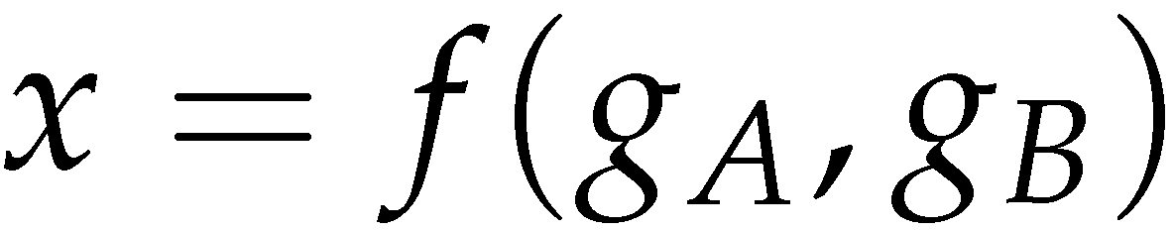
Secure Two-Party Computation
Bob’s Genome: ACTG…
Markers (~1000): [0,1, …, 0]
Alice’s Genome: ACTG…
Markers (~1000): [0, 0, …, 1]
Bob
Alice
Can Alice and Bob compute a function of their private data, without exposing anything about their data besides the result?
Notes:
Both privacy and collaboration are very important
Lots of motivating applications
Genomics
Biometric identification
Encryption

Slide 3
Overview
Describe a system for secure 2-party computation using garbled circuits that is much more scalable and significantly faster than best prior work
Applications:
  Face recognition: Hamming distance
  Genomics: Edit distance, Smith-Waterman
  Private encryption: Oblivious AES evaluation

Slide 4
Our Results
Scalability
Performance
Notes:
People have done this before. What’s new here is achieving performance & scalability needed for realistic problems.

Slide 5
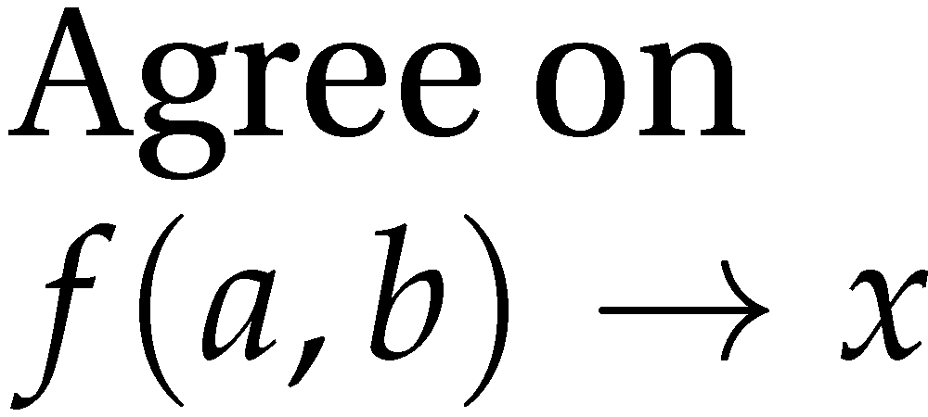
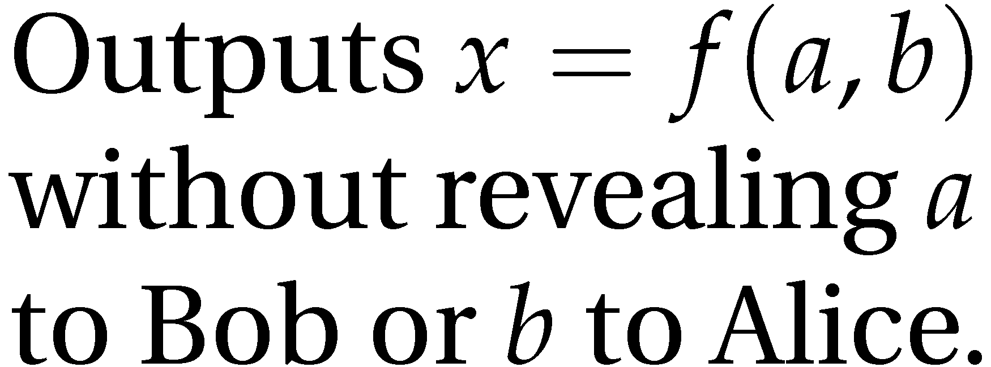
Secure Function Evaluation
Alice (circuit generator)
Bob (circuit evaluator)
Holds
Holds
Garbled Circuit Protocol
Andrew Yao, 1986

Slide 6
Yao’s Garbled Circuits
Inputs |  | Output
a | b | x
0 | 0 | 0
0 | 1 | 0
1 | 0 | 0
1 | 1 | 1
a
b
AND
x

Slide 7
Computing with Meaningless Values?
Inputs |  | Output
a | b | x
a₀ | b₀ | x₀
a₀ | b₁ | x₀
a₁ | b₀ | x₀
a₁ | b₁ | x₁
a₀ or a₁
b₀ or b₁
a_{i}, b_{i}, x_{i} are random values, chosen by the circuit generator but meaningless to the circuit evaluator.
AND
x₀ or x₁

Slide 8
Computing with Garbled Tables
Inputs |  | Output
a | b | x
a₀ | b₀ | Enc_{a0,b0}(x₀)
a₀ | b₁ | Enc_{a0,b1}(x₀)
a₁ | b₀ | Enc_{a1,b0}(x₀)
a₁ | b₁ | Enc_{a1,b1}(x₁)
Bob can only decrypt one of these!
a₀ or a₁
b₀ or b₁
Garbled And Gate
Enc_{a0, b1}(x₀)
Enc_{a1,b1}(x₁)
Enc_{a1,b0}(x₀)
Enc_{a0,b0}(x₀)
a_{i}, b_{i}, x_{i} are random values, chosen by the circuit generator but meaningless to the circuit evaluator.
AND
Randomly permute
x₀ or x₁

Slide 9
Chaining Garbled Circuits
And Gate 1
Enc_{a10, b11}(x1₀)
Enc_{a11,b11}(x1₁)
Enc_{a11,b10}(x1₀)
Enc_{a10,b10}(x1₀)
a0
b0
a1
b1
AND
AND
x0
x1
Or Gate 2
Enc_{x00, x11}(x2₁)
Enc_{x01,x11}(x2₁)
Enc_{x01,x10}(x2₁)
Enc_{x00,x10}(x2₀)
OR
x₂
…
Can do any computation privately this way!

Slide 10
Threat Model
Semi-Honest (Honest-but-Curious) Adversary
Adversary follows the protocol as specified (!), but tries to learn more from the protocol execution transcript
May be good enough for some scenarios
We are working on efficient solutions for malicious adversaries
Notes:
First step towards protocols that resist malicious adversaries
General techniques for converting protocols secure in semi-honest model to resist malicious adversary
Amount of information that could leak without detection is probably small

Slide 11
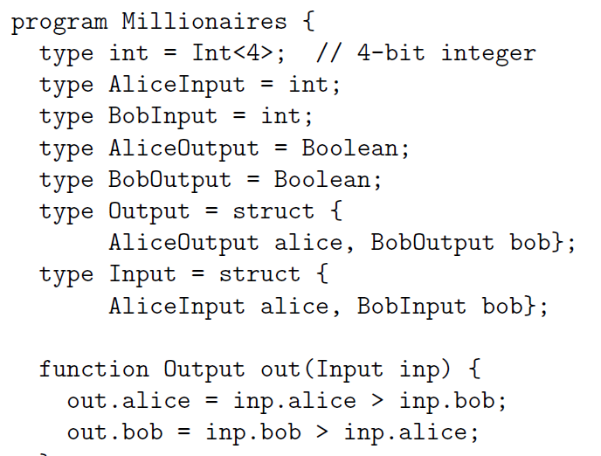
Fairplay
SFDL Compiler
SFDL Program
Circuit
(SHDL)
Alice
Bob
Garbled Tables Generator
Garbled Tables
Garbled Tables Evaluator
Dahlia Malkhi, Noam Nisan, Benny Pinkas and Yaron Sella [USENIX Security 2004]

Slide 12
Problems?
An alternative approach … would have been to apply Yao’s generic secure two-party protocol…. This would have required expressing the algorithm as a circuit … and then sending and computing that circuit.… [We] believe that the performance of our protocols is significantly better than that of applying generic protocols.
Margarita Osadchy, Benny Pinkas, Ayman Jarrous, Boaz Moskovich.
SCiFI – A System for Secure Face Identification. Oakland 2010.
[Generic SFE] is very fast … but the circuit size is extremely large…. Our prototype circuit compiler can compile circuits for problems of size (200, 200) but uses almost 2 GB of memory to do so…. larger circuits would be constrained by available memory for constructing their garbled versions.
Somesh Jha, Louis Kruger, Vitaly Shmatikov.
Towards Practical Privacy for Genomic Computation. Oakland 2008.

Slide 13
The Fallacy
SFDL Compiler
SFDL Program
Circuit
(SHDL)
Alice
Bob
Garbled Tables Generator
Garbled Tables
Garbled Tables
Garbled Tables Evaluator
The entire circuit is prepared and stored on both sides

Slide 14
Faster Garbled Circuits
Circuit-Level Application
Circuit Structure
Circuit Structure
GC Framework (Generator)
GC Framework
(Evaluator)
Enc_{x00, x11}(x2₁)
Enc_{x01,x11}(x2₁)
Enc_{x01,x10}(x2₁)
Enc_{x20, x21}(x3₀)
Enc_{x21,x21}(x3₀)
Enc_{x21,x20}(x3₁)
x2₁
Enc_{x20, x31}(x4₁)
Enc_{x21,x31}(x4₁)
Enc_{x21,x30}(x4₀)
x3₁
Enc_{x40, x31}(x5₁)
Enc_{x41,x31}(x5₀)
Enc_{x41,x30}(x5₀)
Enc_{x40, x51}(x6₁)
Enc_{x41,x51}(x6₀)
Enc_{x41,x50}(x6₀)
x4₁
Enc_{x30, x61}(x7₁)
Enc_{x31,x61}(x7₀)
Enc_{x31,x60}(x7₁)
x5₁
x6₀
x7₁
Gates can be evaluated as they are generated: pipelining
Notes:
Circuit structure is small and can be reused;
Each GT can be used only once.
Significance:
1) allow GC to easily scale to arbitrary problem size;
2) indirectly improves time efficiency;

Slide 15
Benefits of Pipelining
Allows GC to scale to circuits of arbitrary size
Improves the time efficiency
We ran circuits with over a billion gates, at a rate of roughly 10 μs per gate.

Slide 16
Problems in Existing (SFDL) Compilers
Resource-demanding SFDL compilation
Many optimization opportunities are missed
It takes hours on a 40GB memory server to compile a SFDL program that implements AES.
Circuit level
Minimize bitwidth
Reduce the number of
non-free gates
Program level
Treat public and secret
values differently

Slide 17
Example: Secure Counter
class Counter {
int c = 0;
void increment(bool b) {
if (b) c++;
}
SFDL requires pre-setting c to a fixed bit width
For best performance, its bit width should be adjusted dynamically
Saves n non-free gates (out of original n log n)
Notes:
Saves n non-free gates out of n*logn.

Slide 18
Circuit Optimization – Edit Distance
for (int i = 1; i < a.length; ++i)
for (int j = 1; j < b.length; ++j) {
T = (a[i] == b[j]) ? 0 : 1;
D[i][j] = min(D[i-1][j]+1, D[i][j-1]+1,
D[i-1][j-1] + T);
}

Slide 19
Circuit Optimization – Edit Distance
D[i-1][j]
D[i][j-1]
D[i-1][j-1]
1
1
AddOneBit
AddOneBit
T
2-Min
AddOneBit
2-Min
D[i][j]

Slide 20
Circuit Optimization – Edit Distance
D[i-1][j]
D[i][j-1]
D[i-1][j-1]
2-Min
T
1
AddOneBit
AddOneBit
2-Min
D[i][j]

Slide 21
Circuit Optimization – Edit Distance
D[i-1][j]
D[i][j-1]
D[i-1][j-1]
2-Min
T
1
2-Min
Mux
AddOneBit
Saves about 28% of gates
D[i][j]

Slide 22
Circuit Library
1
2-Min
T
Through custom circuit design and the use of optimal circuit components, we strive to minimize the number of non-free gates
2-Min
Mux
AddOneBit
V. Kolesnikov and T. Schneider. Improved Garbled
Circuit: Free XOR Gates and Applications. (ICALP), 2008.

Slide 23
Some Results
Problem | Best Previous Result | Our Result | Speedup
Hamming Distance (Face Recognition, Genetic Dating) – two 900-bit vectors | 213s [SCiFI, 2010] | 0.051s | 4176x
Levenshtein Distance (genome, text comparison) – two 200-character inputs | 534s [Jha+, 2008] | 18.4s | 29x
Smith-Waterman (genome alignment) – two 60-nucleotide sequences | [Not Implementable] | 447s | -
AES Encryption | 3.3s [Henecka, 2010] | 0.2s | 16.5x
Scalable: 1 billion gates evaluated at ≈100,000 gates/second on regular PCs
Comparisons are aligned to the same security level in the semi-honest model.

Slide 24
Timing Results
[Jha+, 2008]
[SCiFI, 2010]
29x
faster
4176x
faster
Hamming Distance
(900 bits)
Edit Distance
(200 chars, 8-bits each)

Slide 25
Ease of Use
Our framework assumes no expert knowledge of cryptography
Need basic ideas of Boolean circuits
Circuit designs converted directly to Java programs

Slide 26
Use the Framework
Traditional Java Application
Rest of the Java Program
Circuit Generator
javac
Critical Component
LibraryCircuit
Java code
Circuit Evaluator
Critical Component
Custom Circuit
Critical Component
LibraryCircuit

Slide 27
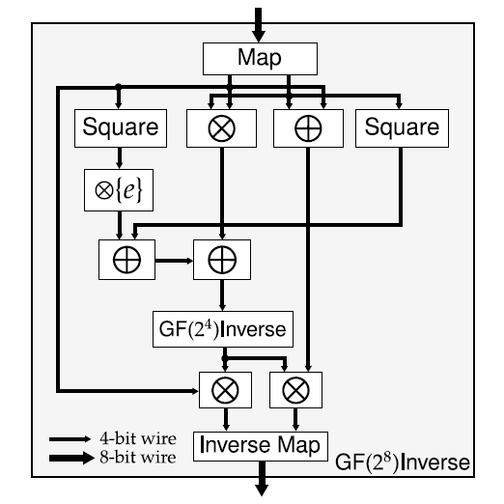
Example: AES SBox
Leveraging an existing ASIC design for AES allows us to reduce the state-of-the-art AES circuit by 30% of non-free gates, compared to [PSSW09] and [HKSSW10]
Wolkerstorfer, et al. An ASIC Implementation of the AES S-boxes. RSA-CT 2002.

Slide 28
Time Savings: AES
16.5x
faster
[Henecka, et al. CCS 2010]

Slide 29
Conclusion
Pipelining enables garbled-circuit technique to scale to large problem sizes
Circuit-level optimizations can dramatically reduce performance overhead
Privacy-preserving applications can run orders of magnitude faster than previously thought.

Slide 30

Questions?
Thanks!
Download framework and Android demo application from MightBeEvil.com

